Slide 1
Image Enhancement with the Application of Local and Global Enhancement Methods for Dark Images
Professor: Nai-Jian Wang
Presenter: Jie-Hong Liu
Date: 2022/3/30

Slide 2
Outline
Recap
Introduction
Methods
Experimental Results
References

Slide 3
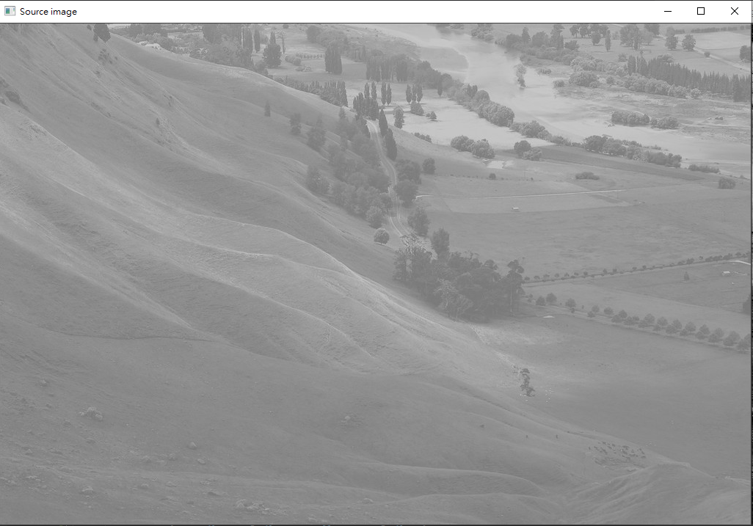
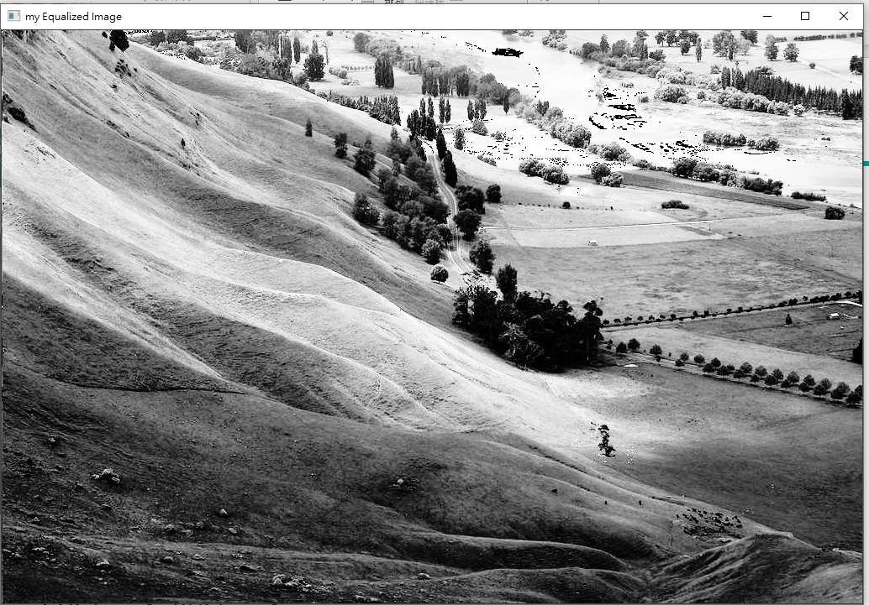
Recap (why gray?)
input
GHE on gray image output

Slide 4
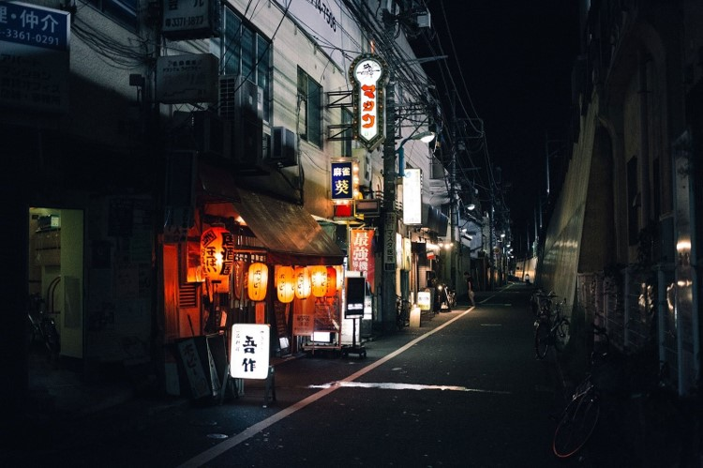
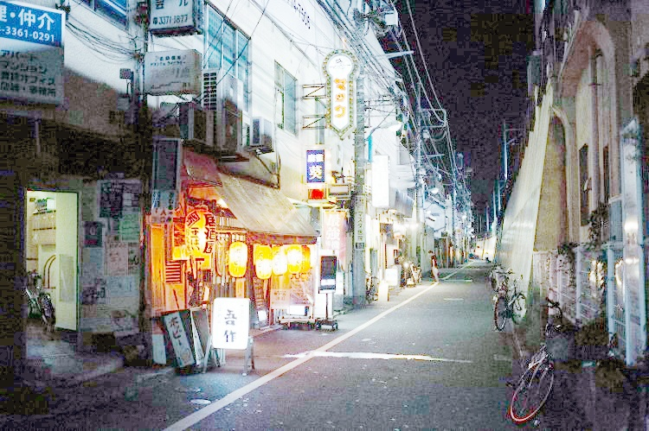
Recap (HE on RGB image)
input
GHE on RGB output

Slide 5
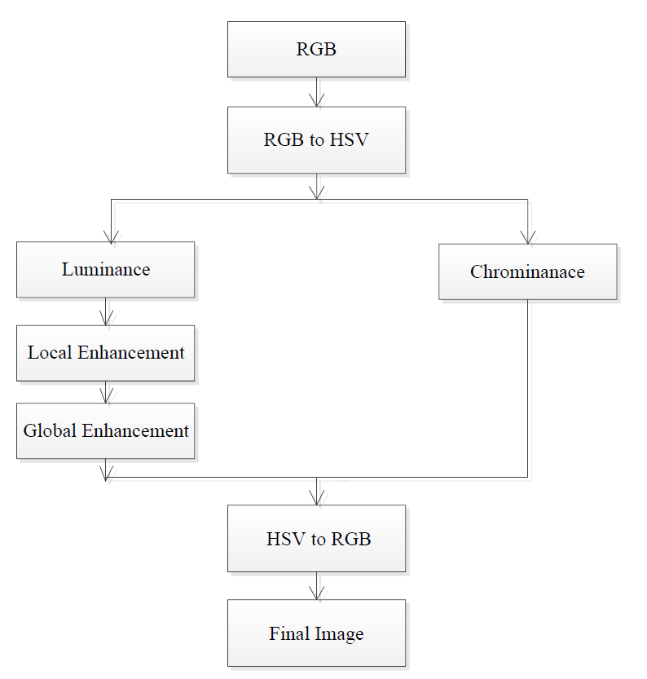
Introduction
1. RGB to HSV
2. Local Enhancement
3. Global Enhancement

Slide 6
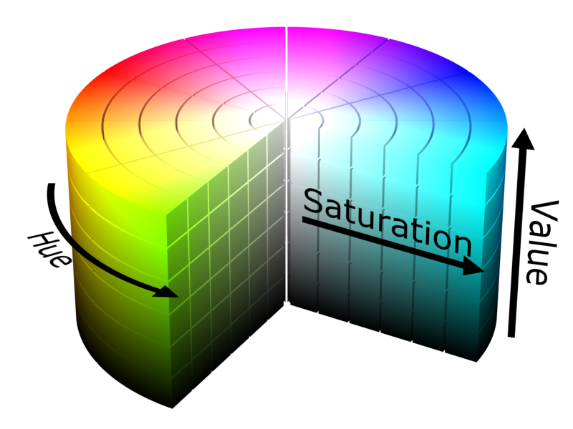
Introduction-HSV
HSV (for hue, saturation, value; also known as HSB, for hue, saturation, brightness) are alternative representations of the RGB color model
Notes:
RGB的圖片是在笛卡爾坐標系的三原色相加組合而成，而HSV的色彩空間是利用圓柱坐標系的方式來表示
因為HSV類似於人類感覺顏色的方式，我們可以對顏色擁有較強的感知度。
RGB是加法原色模型，以原色組合的方式定義顏色，而HSV以人類更熟悉的方式封裝了關於顏色的信息：「這是什麼顏色？深淺如何？明暗如何？」。

Slide 7
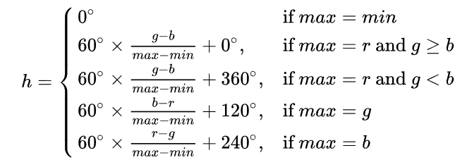
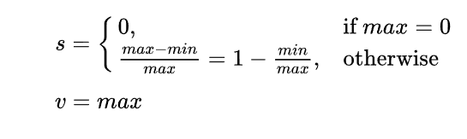
Method - RGB to HSV
RGB -> HSV (Hue, Saturation, value)
Max = max(R,G,B)
Min = min(R,G,B)

Slide 8
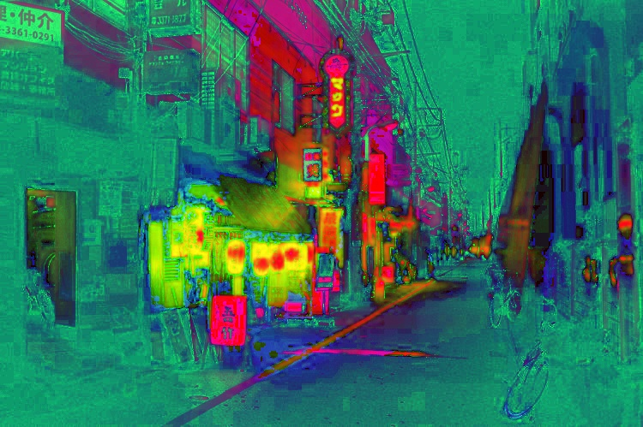
RGB to HSV
Image with RGB color space
Image with HSV color space

Slide 9


Local Enhancement (Unsharp masking)
Steps:
Blurred the image
Subtracting the blurred image from the original image to make the mask
Adding the mask to the original image.
$$m\left(i,j\right)=p\left(i,j\right)−b(i,j)$$
where m is denoted as a mask.
p is denoted as the original image.
b is denoted as the blurred image.
‘w’ is the weight, generally greater than zero.
s is the sharpened image.
when the weight is equal to 1, it is the unsharp masking and when greater than 1, then it is called High boost filter
$$s\left(i,j\right)=p\left(i,j\right)+w∗m(i,j)$$
Notes:
In this method, the image is sharpened by subtracting an unsharp image, that is blurred or smoothed from the original image, so the name unsharp masking is derived.
( 拿原圖減掉模糊的圖，來產出銳利的output )
( 減掉低通濾波成分)

Slide 10
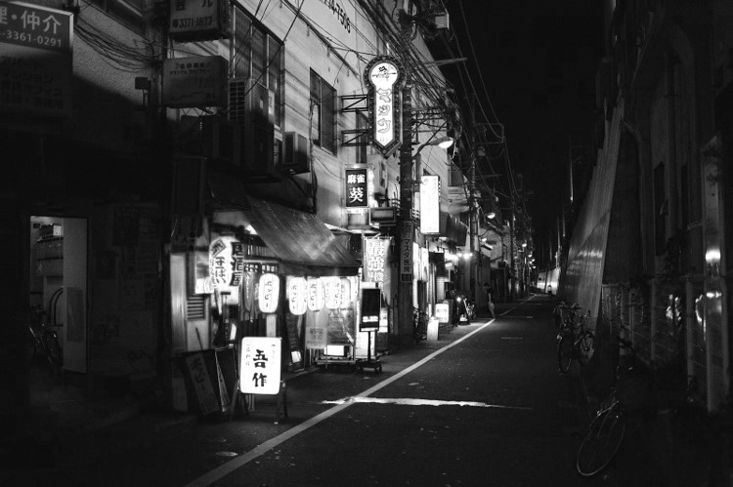

Local Enhancement output – Gaussian Blur
Input Image
Image with Gaussian Blurred

Slide 11
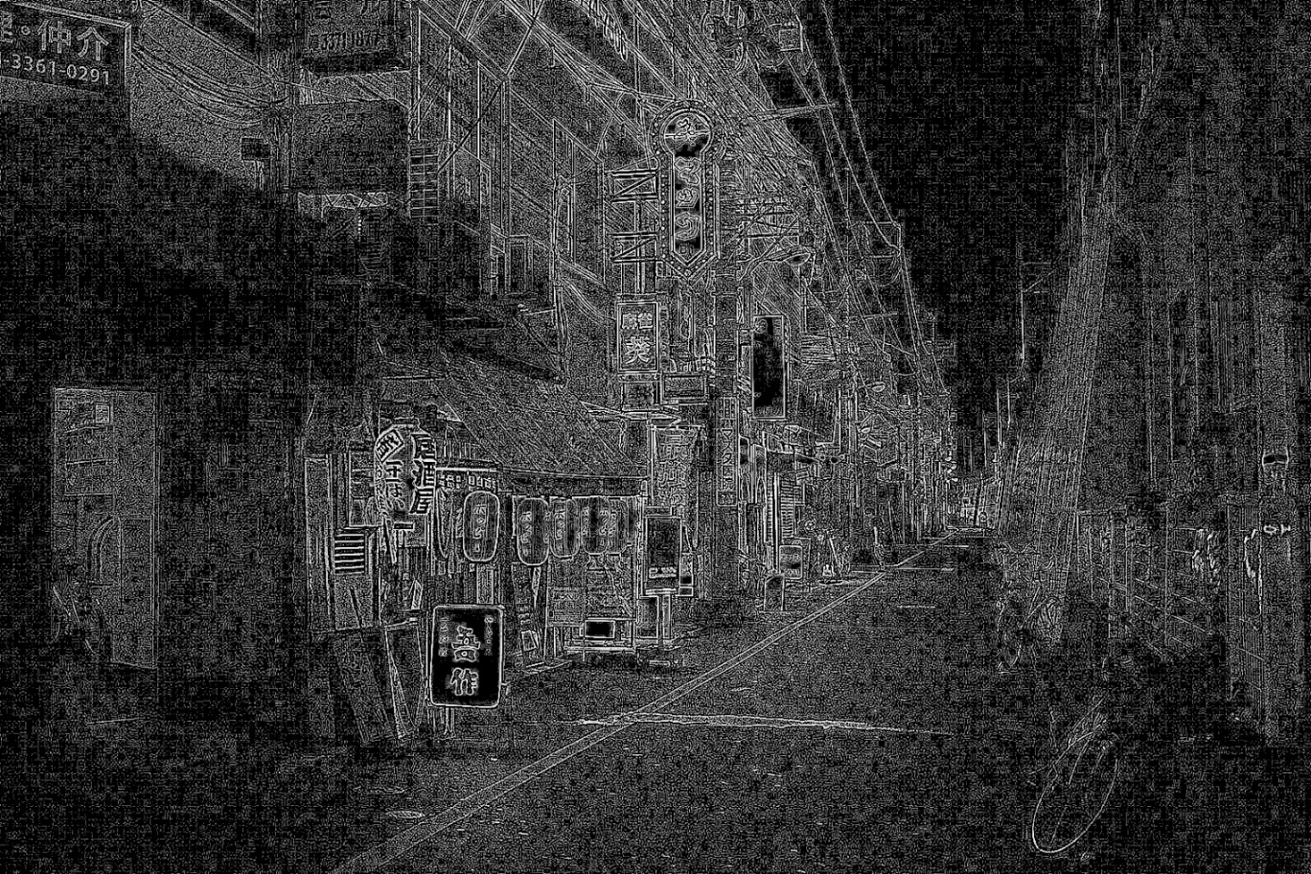

Local Enhancement output –Unsharp masking
The mask of the input image
Add mask and origin input = unsharp mask

Slide 12
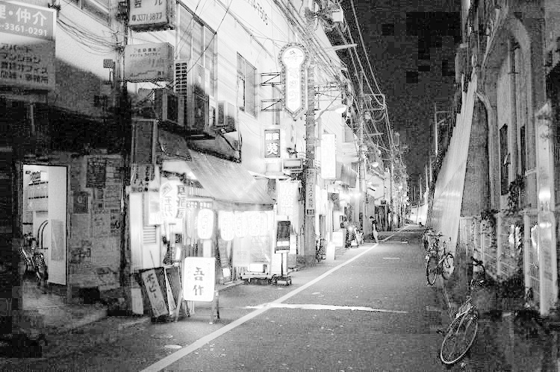
Global Enhancement output – Histogram Equalization
Local Enhancement input
Global Histogram Equalization output

Slide 13
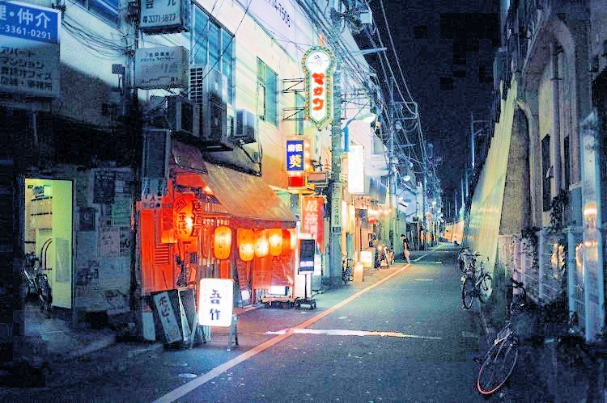
Comparison Enhancement between RGB and HSV method
Applied HE on RGB image
Applied proposed method on HSV image

Slide 14
References
[1] K. B. Singh, T. V. Mahendra, R. S. Kurmvanshi and C. V. Rama Rao, "Image enhancement with the application of local and global enhancement methods for dark images," 2017 International Conference on Innovations in Electronics, Signal Processing and Communication (IESC), 2017, pp. 199-202
[2] M. Abdullah-Al-Wadud, Md. Hasanul Kabir, M. Ali Akber Dewan, and Oksam Chae , “A dynamic histogram equalization for image contrast enhancement”, IEEE Trans. Consumer Electron., May 2007, vol. 53, no. 2, pp. 593- 600
[3] https://en.wikipedia.org/wiki/HSL_and_HSV

